Slide 1
Real or Fake
JOB POST DETECTION
Bangkit Assignment#5
First ML Project
Developed by:
- Ferro Geraldi
- Irfan Abdurahman
- Miftah Ahmad Choiri

Slide 2
Slide Outlines of ASSIGNMENT#5
Google Slide of Our Group Presentation, Containing 10 Slides:
Metadata of the Dataset.
The Job Posting Dataset taken from Kaggle: Real or Fake Jobposting Prediction
Framing & Hypothesis
Preparation Needed
E.g. (Hyperparameters tuning, feature selection, data prep)
Techniques
Result and Conclusion:
Assume that stakeholders don’t have any knowledge in Machine Learning, so please make the result “Humane”
Avoid using Jargon and technical terms that are unnecessary.
Example: if you take supposed to present the result of COVID-19 topic, you’re supposed to present the result of COVID-19 Diagnosis and prediction to the hospital or Ministry of Health Stakeholders.

Slide 3
TABLE OF CONTENTS
01
02
INTRODUCTION
PREPARATION
03
04
TECHNIQUES
CONCLUSIONS
Consist of Metadata and Framing & Hypothesis
Hyperparameters Tuning, Feature Selection, Data Prep
Model Architecture,
Building & Training Process
Result and
Conclusions

Slide 4
INTRODUCTION
The Datasets consist of meta information about the jobs description with total data contains 17880 job post.
01.
The Job Dataset contains out of 17014 are Real Post
02.
The Job Dataset contains out of 866 are Fake Post

Slide 5
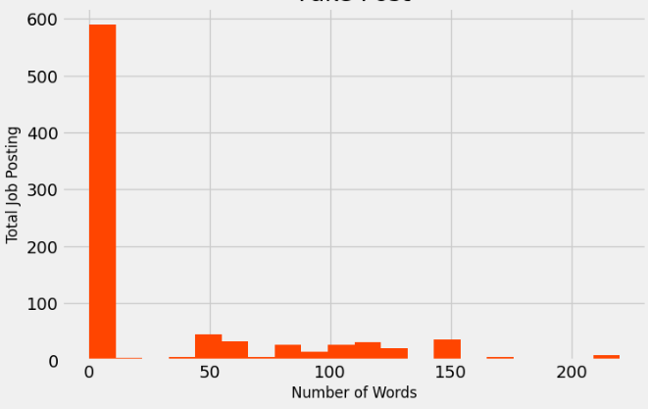
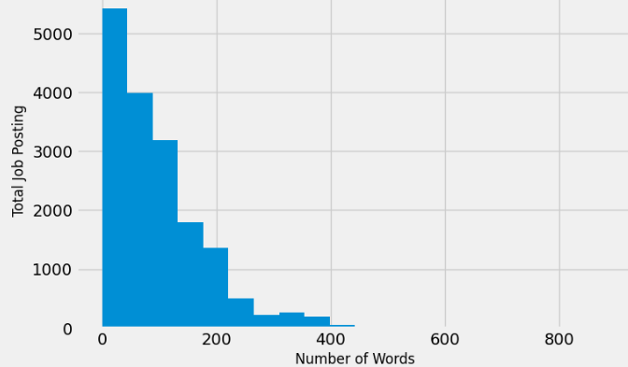
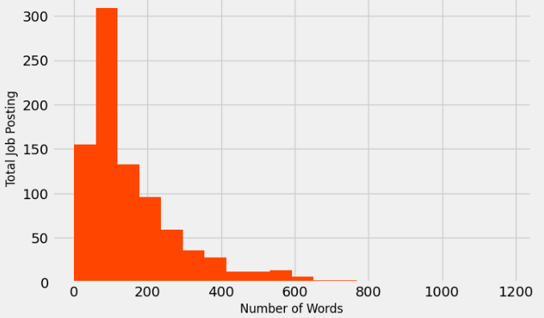
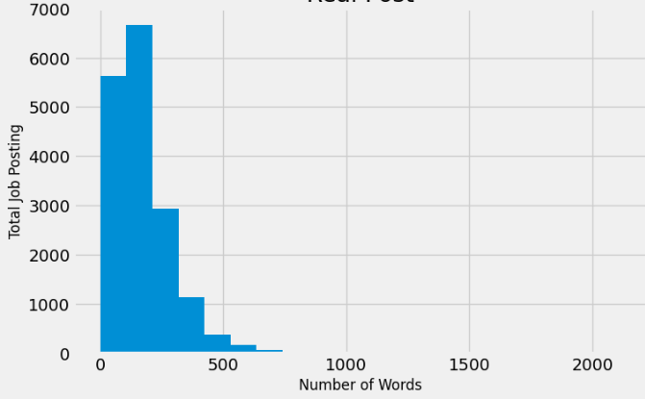
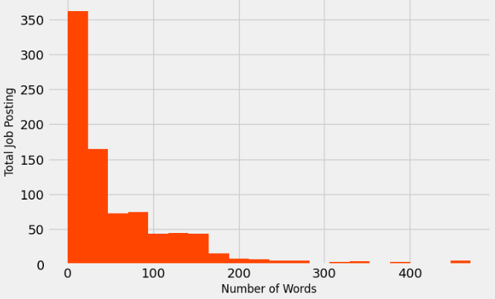
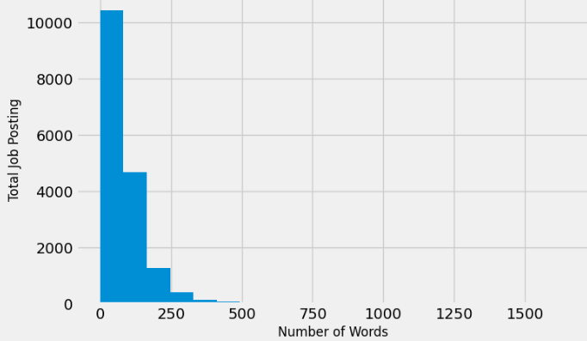
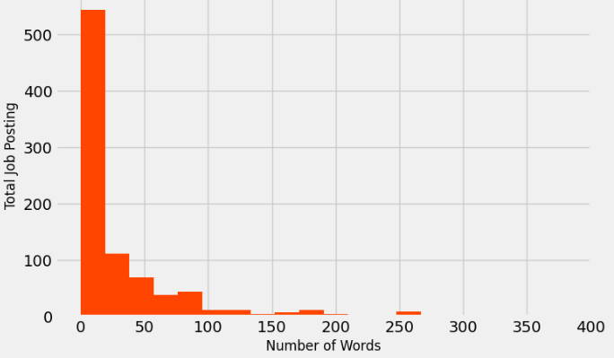
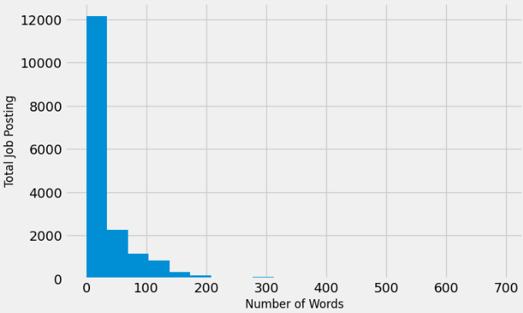
FRAMING & HYPOTHESIS
Number of Words Comparison
FAKE POST
REAL POST
The hypothesis for the Feature that used for training is Company Profile, because it is the most different rather than Description, Requirements, & Benefits
Company
Profile
Description
Requirements
Benefits

Slide 6
DATA CLEAN UP
CLEAN TEXT
Lowercase and replace strip chars, puncts, url link
STOP WORDS
Remove stopwords
LEMMATIZER
Lemmatize words

Slide 7
DATA SAMPLING AND SPLIT
TOTAL
VALIDATION
SET
TRAINING
SET
TEST
SET
3576
14304
2861
11443

Slide 8
TECHNIQUES
ENCODE DATA
BUILD MODEL
TRAIN MODEL
DECODE DATA
01
02
03
04
Transform the Clean Data into Tokenizer, Sequence, and Padded
Build Neural Nets Model with TensorFlow Embedding Layer
Train & Validate the Data with 10 epochs
Transform Padded data into sentences using Reverse_word_index

Slide 9
HYPERPARAMETERS & WORKFLOW
Vocab Size = 60.000
Embedding Dimension = 32
Max Length = 500 Words
Padding Type = ‘post’
Trunc Type = ‘post’
Neural Network Architecture
The Model
Is not Good
(x_trainset, y_trainset)
(x_valset, y_valset)
TRAINING
MODEL
Job Posting
X, Y
(x_testset, y_testset)
TESTING
MODEL
The Model
Is Good
Real Post / Fake Post

Slide 10
MODEL ARCHITECTURE
EMBEDDING
GLOBALAVERAGEPOOLING1D
2X DROPOUT
2X DENSE
Takes padded numbers and establish sentiment
Average across the vector to flatten it out.
Eliminate data to prevent overfitting during training
The regular deeply connected neural network layer

Slide 11
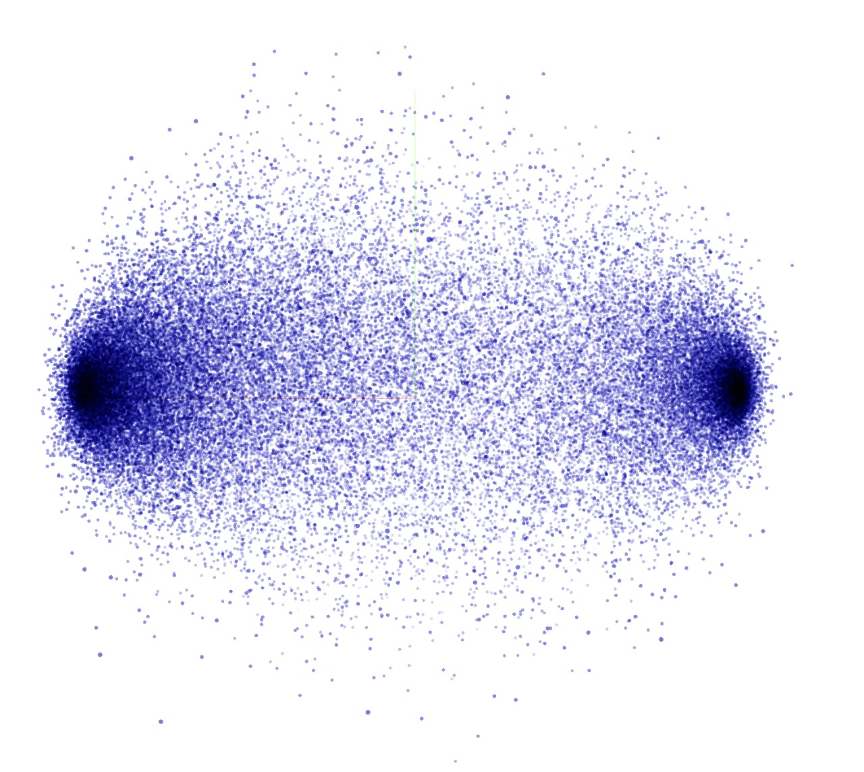
EMBEDDING RESULT
Real Post
Fake Post
60.000 Words in 32 Dimension

Slide 12
Conclusions
Accuracy of Training, Validation, and Testing data approximately equals to +95% that meaning Program we use can Accurately Detect Fake Job Posting

Slide 13
THANK YOU!

